Slide 1


SAP UI5 & FIORI with OData TRAINING
Anubhav Oberoy & Nishan Nainsukha
Day – 2

Slide 2

Agenda – Day 2
Introduction to HTML5
Difference between HTML and HTML5
Introduction to Tags in HTML
Understanding the Attributes
Understanding the Multimedia Tags
Making a form using form Tag
Understanding the GET/POST methods in form
Understanding Document Object Model
Other HTML related terms

Slide 3

Introduction to HTML5
HTML stands for Hyper Text Markup Language, It is used to design static web content. HTML is developed and designed by org named W3C – World Wide Web Consortium.
Markup language is used to define the text document within tag which defines the structure of web pages.
HTML5 is the fifth and current version of HTML. It has improved the markup available for documents and has introduced application programming interfaces(API) and Document Object Model(DOM).
HTML5 is not the next iteration of XHTML. In fact many of the rules that you are accustomed to from your familiarity with XHTML are now changed in HTML5.
HTML5 places the highest value on the user of the website over the HTML craftsman.
Web Visualization with HTML5, CSS3, and JavaScript is the course with the rapidly changing web development technologies, it has become important to stay in line with them to progress within the industry, which is why this course in web virtualization has been brought to you to spruce up your web designing and animating skills using HTML5, CSS3, and JavaScript.
History of HTML
Year | Version
1991 | HTML
1993 | HTML 2.0
1997 | XHTML
1999 | HTML 4
2014 | HTML 5
Trainer: Anubhav Oberoy & Nishan

Slide 4
Difference between HTML & HTML5
HTML stands for Hyper Text Markup Language. It is used to design web pages using a markup language.
There are many differences between HTML and HTML5 which are discussed below:
HTML
HTML 5
No standardized process to handle structurally incorrect HTML code
It supports persistent error handling via improvised error handling process.
It’s not mobile friendly.
It’s mobile friendly.
No audio and video support in HTML
Audio/video elements can be integrated directly onto a web page.
It does not support all major browsers.
It support by all major web browsers.
It does not allow JavaScript to run in background.
It allows JavaScript to run in background.

Slide 5

Some Important Points in HTML
HTML pages contains a header and a body, the body is what user sees.
HTML is a tree data structure
Each HTML element is called tag, we will have starting and ending tags.
Syntax
<tagName property=“value”>Content</tagName>
We can excess the Browser Dev Tools and Developer Toolbar by pressing F12 in the browser window.
HTML is not a programming language, it’s a markup language.
When we test HTML page in Browser, the generated tree data Structure is known as DOM – Document Object Model.
We can excess the HTML Documentation at https://www.w3schools.com/

Slide 6
Introduction to Tags in HTML
HTML tags are like keywords which defines that how web browser will format and display the content. HTML tags contain three main parts: opening tag, content and closing tag. But some HTML tags are unclosed tags.
We can excess the HTML Tags Documentation at https://www.w3schools.com/tags/default.asp
01
01
<br>
br stands for break line, it breaks the line of the code.
<br>
<label>
The <label> tag is used to specify a label for an <input> element of a form.
HTML Tags
<title>
Defines a title for the document
<input>
The <input> tag specifies an input field where the user can enter data.
08
<p>
It represents a paragraph in an HTML document

Slide 7
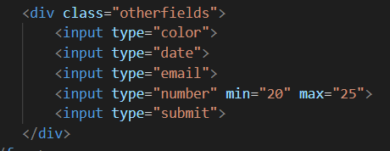

<div> Tag in HTML
The <div> HTML element is the generic container for flow content. It has no effect on the content or layout until styled in some way using CSS (e.g. styling is directly applied to it, or some kind of layout model like Flexbox is applied to its parent element).
The <div> tag defines a division or a section in an HTML document.
The <div> tag is used as a container for HTML elements - which is then styled with CSS or manipulated with JavaScript.
The <div> tag is easily styled by using the class or id attribute.
Any sort of content can be put inside the <div> tag!
By default, browsers always place a line break before and after the <div> element.
The <div> tag also supports the Global Attributes in HTML.
The <div> tag also supports the Event Attributes in HTML.
We can excess the <div> Tag Documentation at https://www.w3schools.com/tags/tag_div.asp
01
08

Slide 8
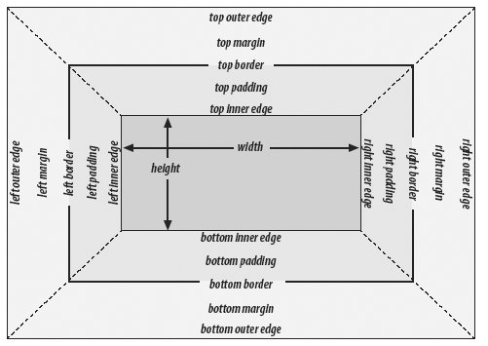
Block level elements in HTML
Every HTML element has a default display value, depending on what type of element it is.
A block-level element always starts on a new line.
A block-level element always takes up the full width available (stretches out to the left and right as far as it can).
A block level element has a top and a bottom margin, whereas an inline element does not.
The <div> element is a block-level element.
HTML (Hypertext Markup Language) elements historically were categorized as either "block-level" elements or "inline-level" elements. The <div> tag defines a division or a section in an HTML document.
A Block-level element occupies the entire horizontal space of its parent element (container), and vertical space equal to the height of its contents, thereby creating a "block".
An inline element cannot contain a block-level element!
HTML block level elements can appear in the body of an HTML page.
Examples of block level elements:
<p>
All headings
<article>, <section>, <div>
<ol>, <ul>, <dl>
08

Slide 9

Exercise
In this exercise we will add anchor tag and Image.
Adding anchor tag for link.
Adding Image tag and image will be clickable.
.
Exercise Code:
index.html
images

Slide 10
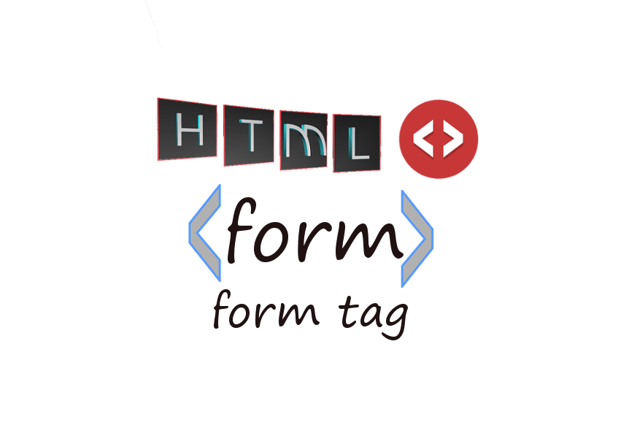
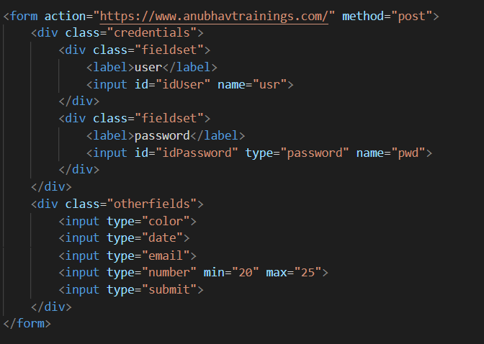
Form Tag in HTML
The HTML <form> tag is used for creating a form for user input.
A form can contain textfields, checkboxes, radio-buttons and more. Forms are used to pass user-data to a specified URL.
The <form> tag also supports the Global Attributes in HTML.
Most browsers will display the <form> element with the following default values:
form { display: block; margin-top: 0em; }

Slide 11

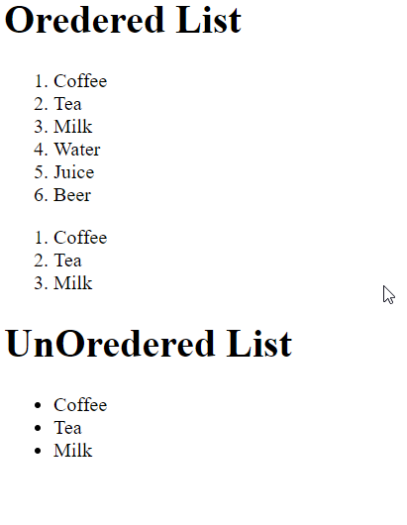
List Tag in HTML
The <li> tag defines a list item.
The <li> tag is used inside ordered lists(<ol>), unordered lists (<ul>), and in menu lists (<menu>).
In <ul> and <menu>, the list items will usually be displayed with bullet points.
In <ol>, the list items will usually be displayed with numbers or letters.
The HTML <ol> tag defines an ordered list. An ordered list can be numerical or alphabetical.
HTML Lists are used to specify lists of information. All lists may contain one or more list elements.
Exercise code links:
index.html

Slide 12

Understanding the multimedia Tags
HTML helps you to add multimedia files on your website by providing various multimedia tags. ... These tags include AUDIO, VIDEO, EMBED, and OBJECT. The AUDIO tag is used to display the audio file on the Web page, whereas the VIDEO tag is used to display the video files on the Web page. To access the methods and properties of a UI Control, We cannot use the document object which is a plain HTML element object.
HTML Attributes Documentation at https://www.w3schools.com/html/html_media.asp
0
2
The HTML <video> element is used to show a video on a web page.
The HTML <audio> element is used to play an audio file on a web page
Video
Audio
Multimedia Tags
Plug-ins
YouTube
Plug-ins are computer programs that extend the standard functionality of browser
This is the easiest way to play videos in HTML
03
04

Slide 13
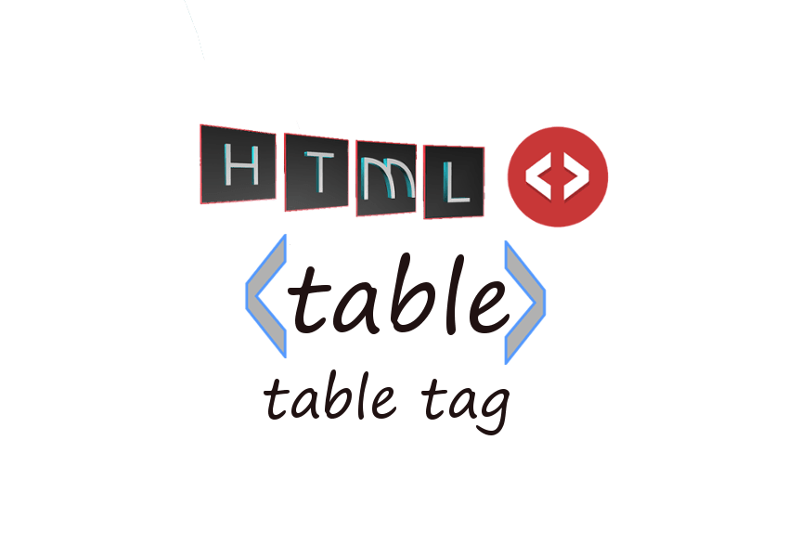
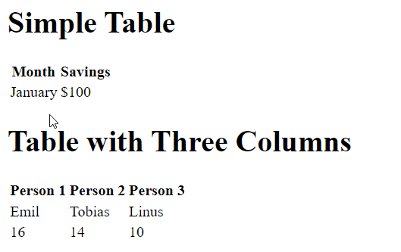

Table Tag in HTML
HTML tables allow web developers to arrange data into rows and columns.
A table in HTML consists of table cells inside rows and columns A simple HTML table, containing two columns and two rows
The <table> tag defines an HTML table.
An HTML table consists of one <table> element and one or more <tr>, <th>, and <td> elements.
The <tr> element defines a table row, the <th> element defines a table header, and the <td> element defines a table cell.
An HTML table may also include <caption> <colgroup>, <thead>, <tfoot>, and <tbody> elements.
By default, the text in <th> elements are bold and centered, but you can change that with CSS.
Exercise code link
index.html

Slide 14
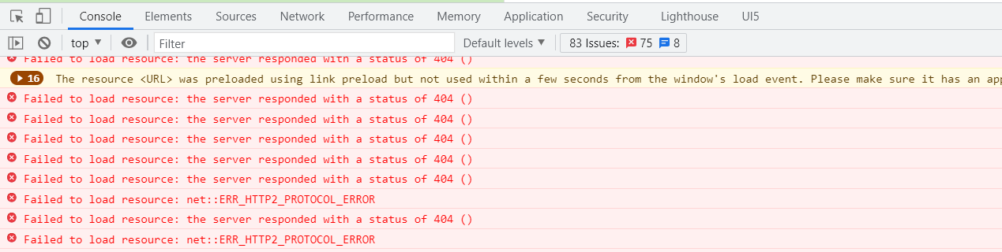
Browser Developer Tools
We can open the console by pressing F12.
There are different types of section in Console: Console, Elements, Source, Network, Performance, Memory, Security etc.
The Console tab is used to output information (including errors and warnings) issued by the browser itself and by the webpage author (using JavaScript console.log messages).
The Network tab shows all network traffic generated by the HTML page while it was loading and during its lifetime.
the Sources tab allows you to set breakpoints and evaluate expressions in Javascript.
The Elements tab lets you see all the web page elements that were rendered from the HTML and CSS.

Slide 15
Introduction to GET/POST methods
What is HTTP?
The Hypertext Transfer Protocol (HTTP) is designed to enable communications between clients and servers.
HTTP works as a request-response protocol between a client and server.
The two most common HTTP methods are: GET and POST.
GET
POST
GET is used to request data from a specified resource.
POST is used to send data to a server to create/update a resource.
<br>
GET requests can be cached
POST requests are never cached
GET requests remain in the browser history
POST requests do not remain in the browser history
GET requests can be bookmarked
POST requests cannot be bookmarked
GET requests have length restrictions
POST requests have no restrictions on data length

Slide 16

Exercise
In this exercise we will create a Form using Form Tag.
Adding some Input fields, Label, Button.
On Button press going on New DOM.
.
Exercise Code:
index.html

Slide 17

Introduction to Document of Object Model
The Document Object Model (DOM) is a programming API for HTML and XML documents
It defines the logical structure of documents and the way a document is accessed and manipulated.
In the DOM specification, the term "document" is used in the broad sense - increasingly, XML is being used as a way of representing many different kinds of information that may be stored in diverse systems, and much of this would traditionally be seen as data rather than as documents.
With the Document Object Model, programmers can create and build documents, navigate their structure, and add, modify, or delete elements and content.
The Document Object Model is a programming API for documents. The object model itself closely resembles the structure of the documents it models.
The HTML DOM Tree of Objects

Slide 18

End of Day 2

Slide 19

Questions

Slide 20

Anubhav Oberoy

Slide 21


We’re committed to empower you to be
Most Desirable Resource
through powerful training solutions.
We build the workforce of the future.
250+
Corporate Clients
30,000+
Learners Trained
25000+
Learners Placed
FREE WEBINARS
Sign up for free webinars with industry experts every fortnight!
Enroll Now!
Contact us today!
https://anubhavtrainings.com/

Slide 22




More from AnubhavTrainings.com

Slide 23
Title
Content

